Slide 1





How to Create a Progressive Web Application

Slide 2
Issues with regular websites
Offline Access:
Website crashes in poor connections or during network outages.
No Native-Like User Experiences
59% of internets users are mobile users¹
Website are difficult to navigate on mobile devices
Lower performance on mobile devices
Mobile devices have worse processors than desktop
https://gs.statcounter.com/platform-market-share/desktop-mobile-tablet

Slide 3
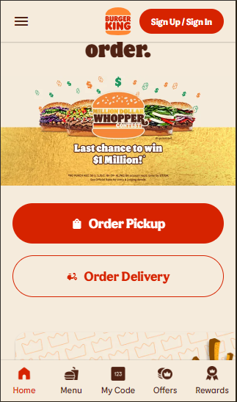
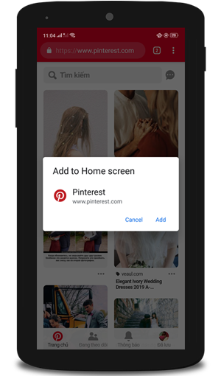
What is PWA?
An app that's built using web platform technologies, but provides a user experience like that of a platform-specific app

Slide 4
Key Features
Progressive Enhancement:
Basic accessibility for all users. More powerful devices get extra enhancements¹
Ex. animations
Responsive Design:
Adapts seamlessly to various screen sizes and orientations, providing a consistent experience across devices¹.
Connectivity Independence:
Can function offline or on low-quality networks, using local storage (cache, assets, etc)¹
Security:
Requires HTTPS, ensuring secure communication and protecting users' data and privacy¹.
https://www.divante.com/reports/pwabook/features-of-progressive-web-apps

Slide 5



Core Technologies and Components
Service Workers
Web App Manifest
HTTPS

Slide 6
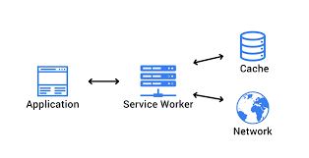
Service Workers
Definition:
Service Workers are a virtual proxy between the browser and the network
Usage:
Offline Functionality
Cached resources are stored locally. Ex: files, images
Background Scripting
Act as proxy servers intercepting network requests made by the application.²
Network Interception
intercept network requests made by the PWA, create custom logic for handling requests
Background Sync
synchronize data with the server when the device reconnects to the network.³
https://www.divante.com/reports/pwabook/features-of-progressive-web-apps
https://developer.mozilla.org/en-US/docs/Web/API/Service_Worker_API/Using_Service_Workers
https://learn.microsoft.com/en-us/microsoft-edge/progressive-web-apps-chromium/how-to/background-syncs

Slide 7
Web App Manifest
Definition:
a JSON file that defines how the application should behave when installed.¹
Usage:
Metadata Definition
metadata about the PWA, including its name, short name, description, and start URL.
Specify App Icons and Splash Screens
Set Display Modes²
Ex: "fullscreen," "standalone," "minimal-ui," and "browser."
Orientation Lock - lock the screen orientation
Theme Color - sets the color of the browser's address bar
https://web.dev/articles/add-manifest#:~:text=A%20web%20app%20manifest%20is,icons%20the%20app%20should%20use
https://dev.to/azure/11-displaying-content-more-like-an-app-10md

Slide 8
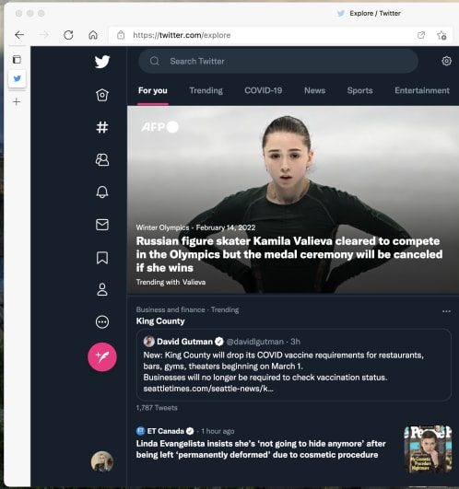
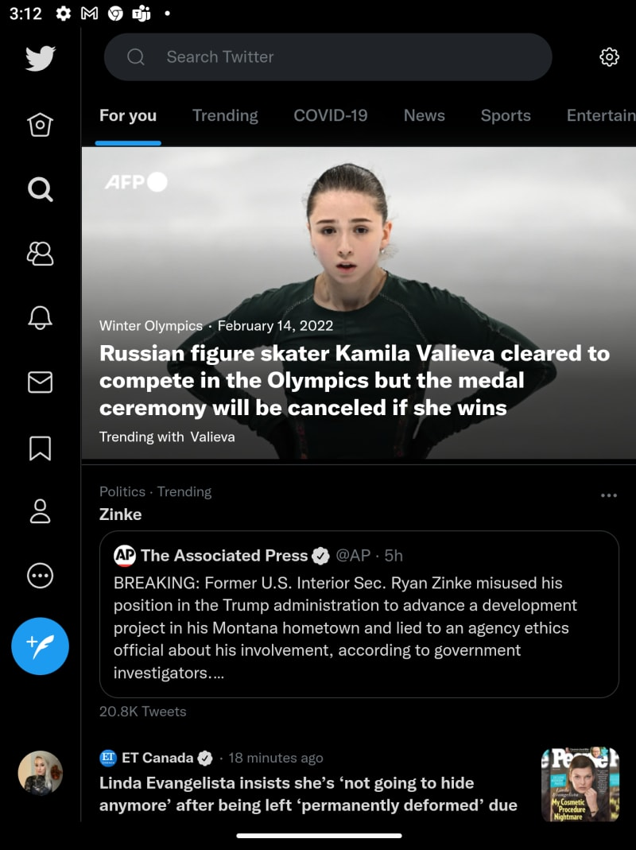
Web App Manifest - display modes
Browser display mode
Normal browser
Web app will not be installable
Standalone display mode
Looks like a native app.
It opens in a different window from the browser and hides all the browser UI elements like the address bar.
https://www.divante.com/reports/pwabook/features-of-progressive-web-apps

Slide 9
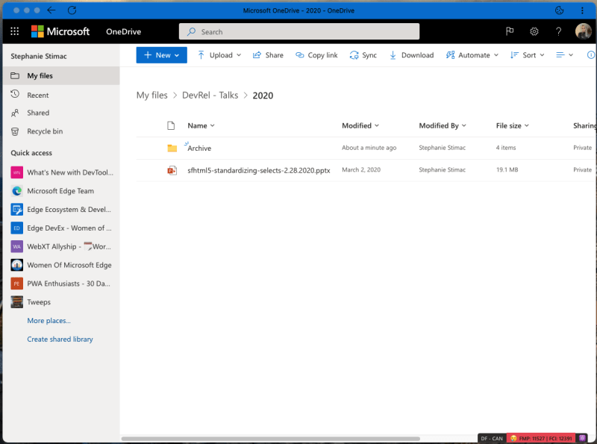

Web App Manifest - display modes
Fullscreen display mode
Takes all of the display area available and hides all of the browser UI elements.
Minimal-UI display mode
It opens in its own window, but the application retains a minimal set of browser UI controls
https://www.divante.com/reports/pwabook/features-of-progressive-web-apps

Slide 10
HTTPS
Definition:
Hypertext Transfer Protocol Secure is a protocol that secures communication and data transfer between a user's web browser and a website¹
Usage:
Security & Data Integrity
It encrypts and verifies the integrity of data transmitted between the user's browser and the web server. Ex: Login info, payment details
User Trust:
HTTPS is a signal of trust and credibility to users.
Service Worker Functionality
PWAs are required to use HTTPS.
https://www.techtarget.com/searchsoftwarequality/definition/HTTPS

Slide 11
Pros & Cons
➕
➖

Slide 12
Pros
➕
Cross-Platform Compatibility:
Can run on any device with a web browser.
Accessible to a wide audience.¹
Lower Development Costs:
a single codebase for multiple platforms = cost-effective.¹
Easy Installation:
Installed directly from the browser. ¹
Improved Performance:
Service workers and caching provides fast load times even on slow or unreliable networks.¹
https://waverleysoftware.com/blog/why-use-flutter-pros-and-cons/

Slide 13
Cons
➖
Limited Native Functionality
Can’t access device-specific functionalities
Bluetooth, NFC, Camera¹
Storage Limitations
a single codebase for multiple platforms = cost-effective.¹
High battery consumption
Web apps constantly update data because of limited storage¹
Security Concerns
More vulnerable to cyberattacks and require additional security measures¹
https://waverleysoftware.com/blog/why-use-flutter-pros-and-cons/

Slide 14
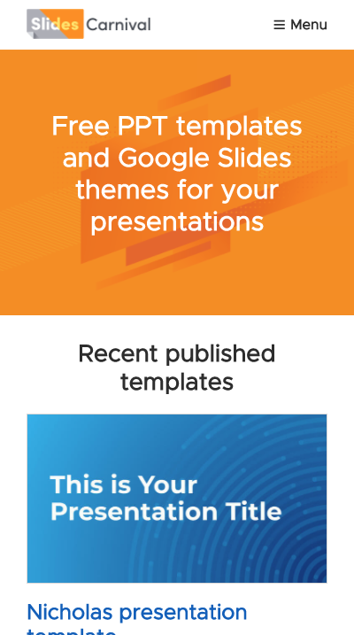
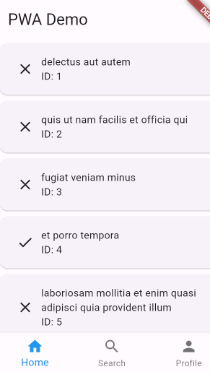
Here’s a demo PWA using Flutter

Slide 15

What is Flutter?
An open-source software development kit created by Google. Which enables smooth and easy cross-platform mobile app development
https://www.divante.com/reports/pwabook/features-of-progressive-web-apps

Slide 16

Thanks!
Any questions?

